Slide 1

PCN12203-Wireless Communication
Department of Network and Security
Unguided Media
Isuru Sri Bandara
isuru.s@nsbm.ac.lk

Slide 2
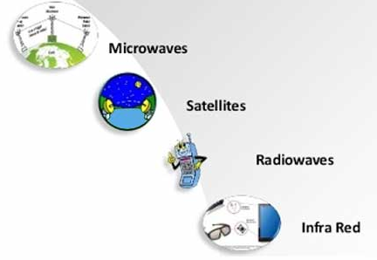
Unguided Media
It is also referred to as wireless or unbound transmission media.
No physical medium is required for the transmission of electromagnetic signals.
Features
Signal is broadcasting through air
Used for larger distances

Slide 3
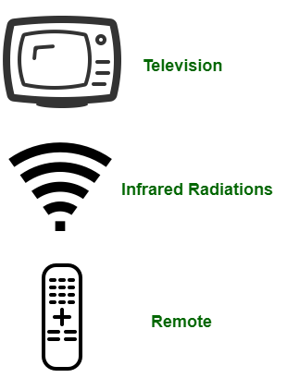
Infrared Transmissions
Achieved using transceivers that modulate non coherent infrared light
Transceivers must be within line of sight of each other directly or via reflection
Does not penetrate walls
No frequency allocation issues

Slide 4
Antennas

Slide 5
What is an Antenna ?

Slide 6

What is an Antenna ?
Antenna is an electrical device which converts electric currents into radio waves & vice versa. An antenna is generally used with a radio transmitter or radio receiver.
Electrical conductor or systems of conductors used to radiate or collect electromagnetic energy.
Radio frequency, electrical energy from the transmitter is converted into electromagnetic energy by the antenna and radiate into the surrounding environment
In two-way communication, the same antenna can be used for both transmission and reception
.

Slide 7
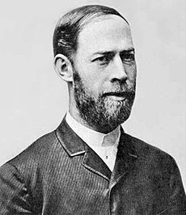
The First Antenna - History
The first antennas were built by German physicist Heinrich Hertz in 1888. That is to prove the existence of electromagnetic waves predicted by the theory of James Clerk Maxwell.
Heinrich Hertz

Slide 8
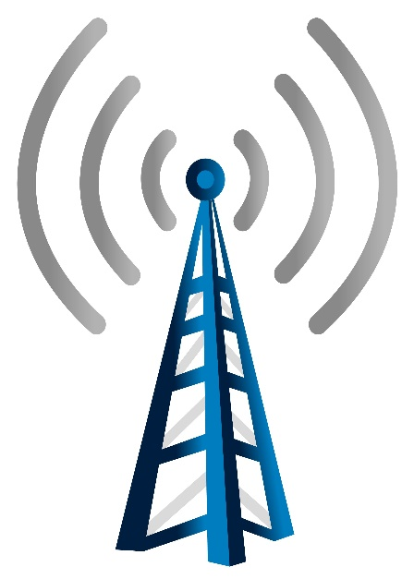
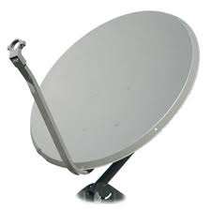
What is an Antenna ?
Transmitter Antenna
Receiver Antenna
An Antenna which converts light, sound or electrical signal into microwave, radio or other electrical signals
An Antenna which converts electromagnetic signal into electrical energy

Slide 9
How it Works ?
Transmitter
An oscillating current of electrons forced through the antenna by a transmitter generates an oscillating magnetic field around the antenna elements (metallic conductors). In the meantime the charge of the electrons also generates an oscillating electric field along the elements. Above noted time varying fields radiates away from the antenna as a moving electromagnetic wave into the space.
Receiver
In reception, the oscillating electric & magnetic fields of an incoming radio wave apply force on the electrons in the antenna elements. It cause them to move back & forth which generates oscillating currents in the antenna.

Slide 10
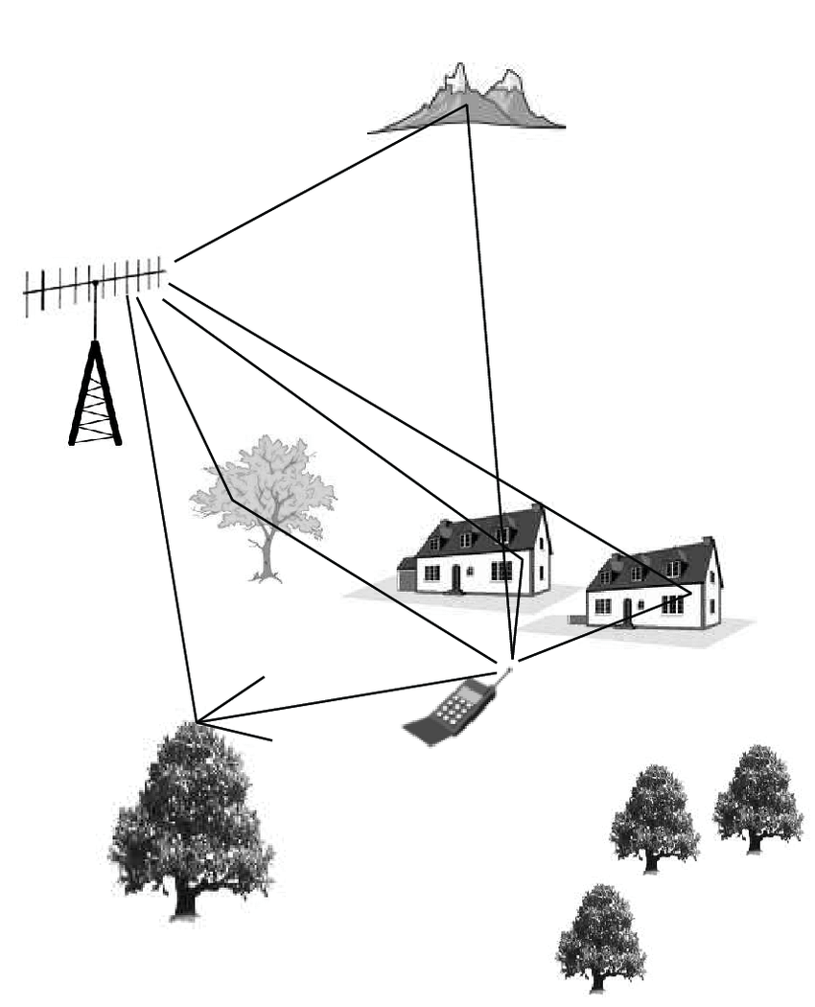
Why it is Required ?
Antennas are required for the communication between two parties in geographically separated locations where the wired connectivity is not available.
Antennas are required by any radio transmitter or receiver to couple its electrical connection to electromagnetic field.
Radio waves are electromagnetic waves which carry signals through air at the speed of light with very minimal transmission loss.
In some instances the antennas are hidden. Ex: The antenna in AM radio, laptops enabled with Wi Fi etc.

Slide 11
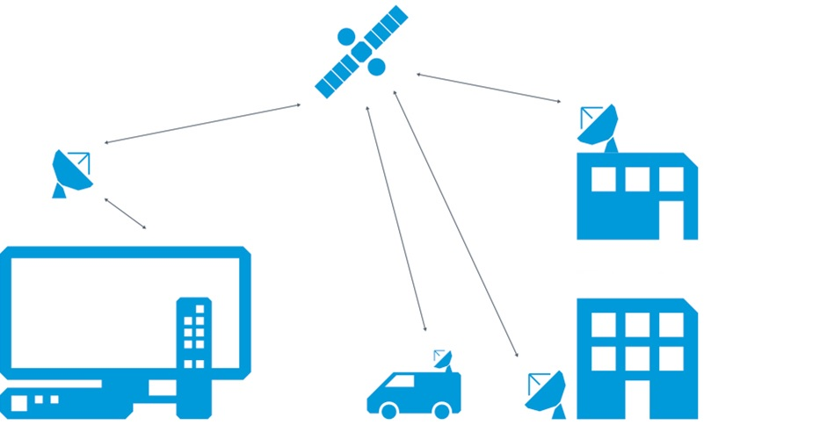
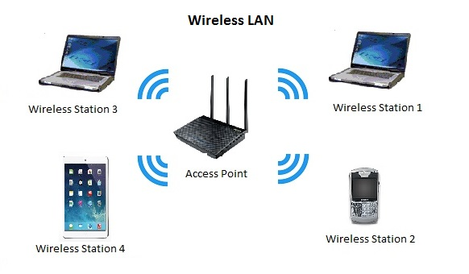
Antenna Applications
Broadcast television
Radio broadcasting
Point-to-point radio communication
Wireless LAN
Radar
Satellite communication
Cell phones

Slide 12
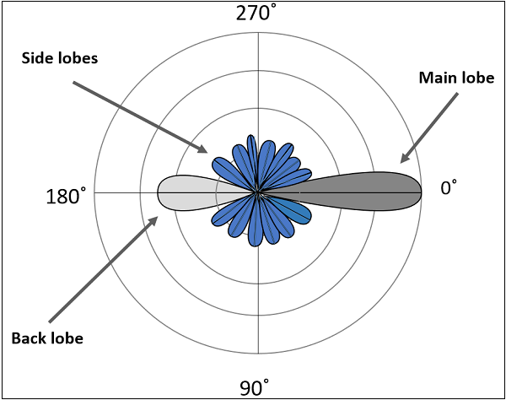
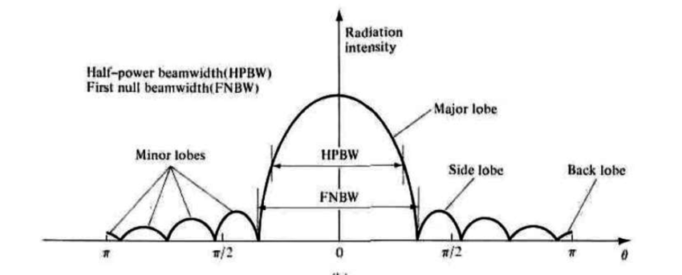
Radiation Patterns
Radiation pattern defines the variation of power radiated by an antenna as a function of the direction away from the antenna. It’s a pictorial/mathematical representation of the distribution of the power out flowing from the antenna (in transmitting antennas), or in flowing to the antenna (in receiving antennas) as a function of direction angles from the antenna.

Slide 13
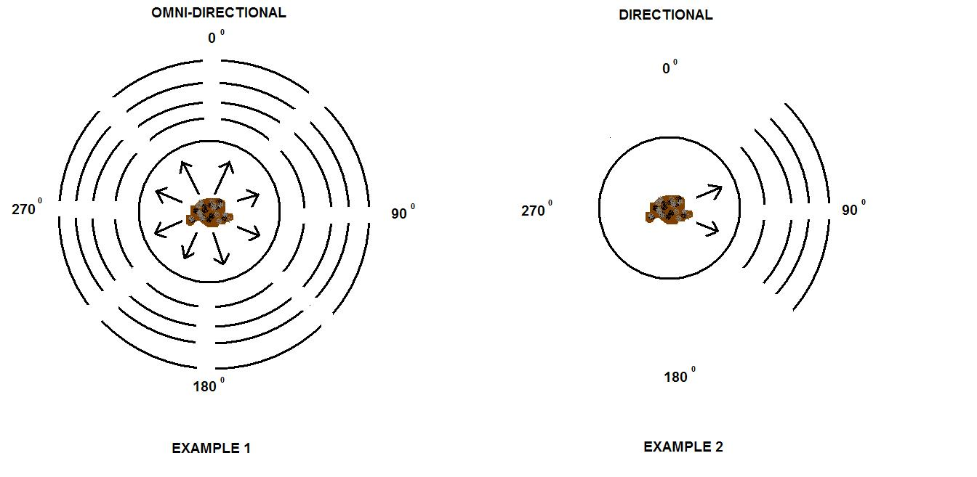
Antenna Types
According to the applications & technology, antennas are broadly classified into 2 categories:
Radiate or receive more or less in all directions. These are employed when the relative position of the other station is unknown. Used at lower frequencies where a directional antenna would be too large.
Omni-directional Antennas
Directional (Beam) Antennas
Preferentially radiate or receive in a particular direction.

Slide 14
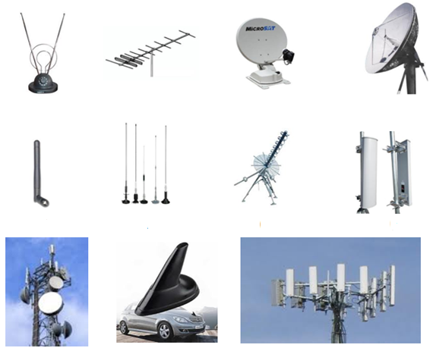
Antenna Types
Yagi – Uda Antenna
Parabolic Antenna
Helix Antenna
Loop Antenna
Horn Antenna

Slide 15
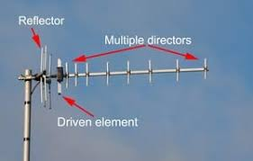
Yagi – Uda Antenna
Unidirectional antenna
Frequency range (300 MHz ~ 3 GHz)
Narrow bandwidth
Higher gain
Higher directivity due to director & reflector
Fixed frequency device

Slide 16
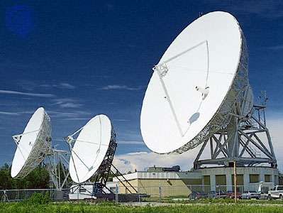
Parabolic Antenna
Often referred as Dish Antenna
Frequency range (3 GHz ~ 30 GHz)
Higher directivity & gain
Produce sharp & narrow beam width
Radiates & receives signal in one direction only
Use in satellite communication/ radar communication

Slide 17
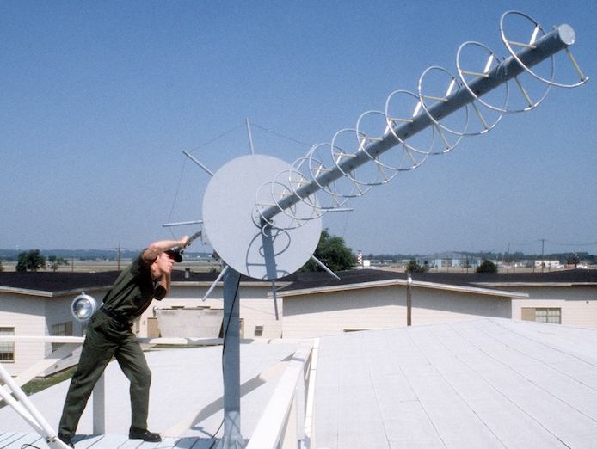
Helix Antenna
Omnidirectional antenna
Frequency range – VHF & UHF band
A conducting wire in the form of screw thread fed by power source
The feedline is connected between the bottom of the helix and the ground plane
Use in space communication/ satellite communication/ telemetry applications etc.

Slide 18
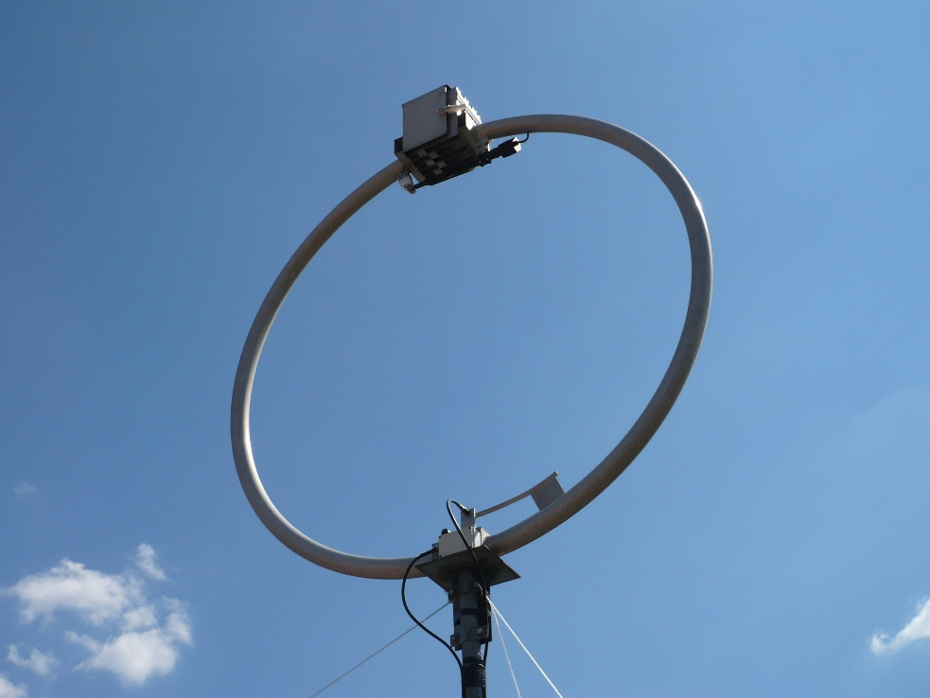
Loop Antenna
Directional antenna
Consists of one or more complete turns of a conductor
Frequency range (500 KHz ~ 1,600 KHz)
Use in long distance Point-to-Point communication/ Radio (AM – FM) receiption

Slide 19
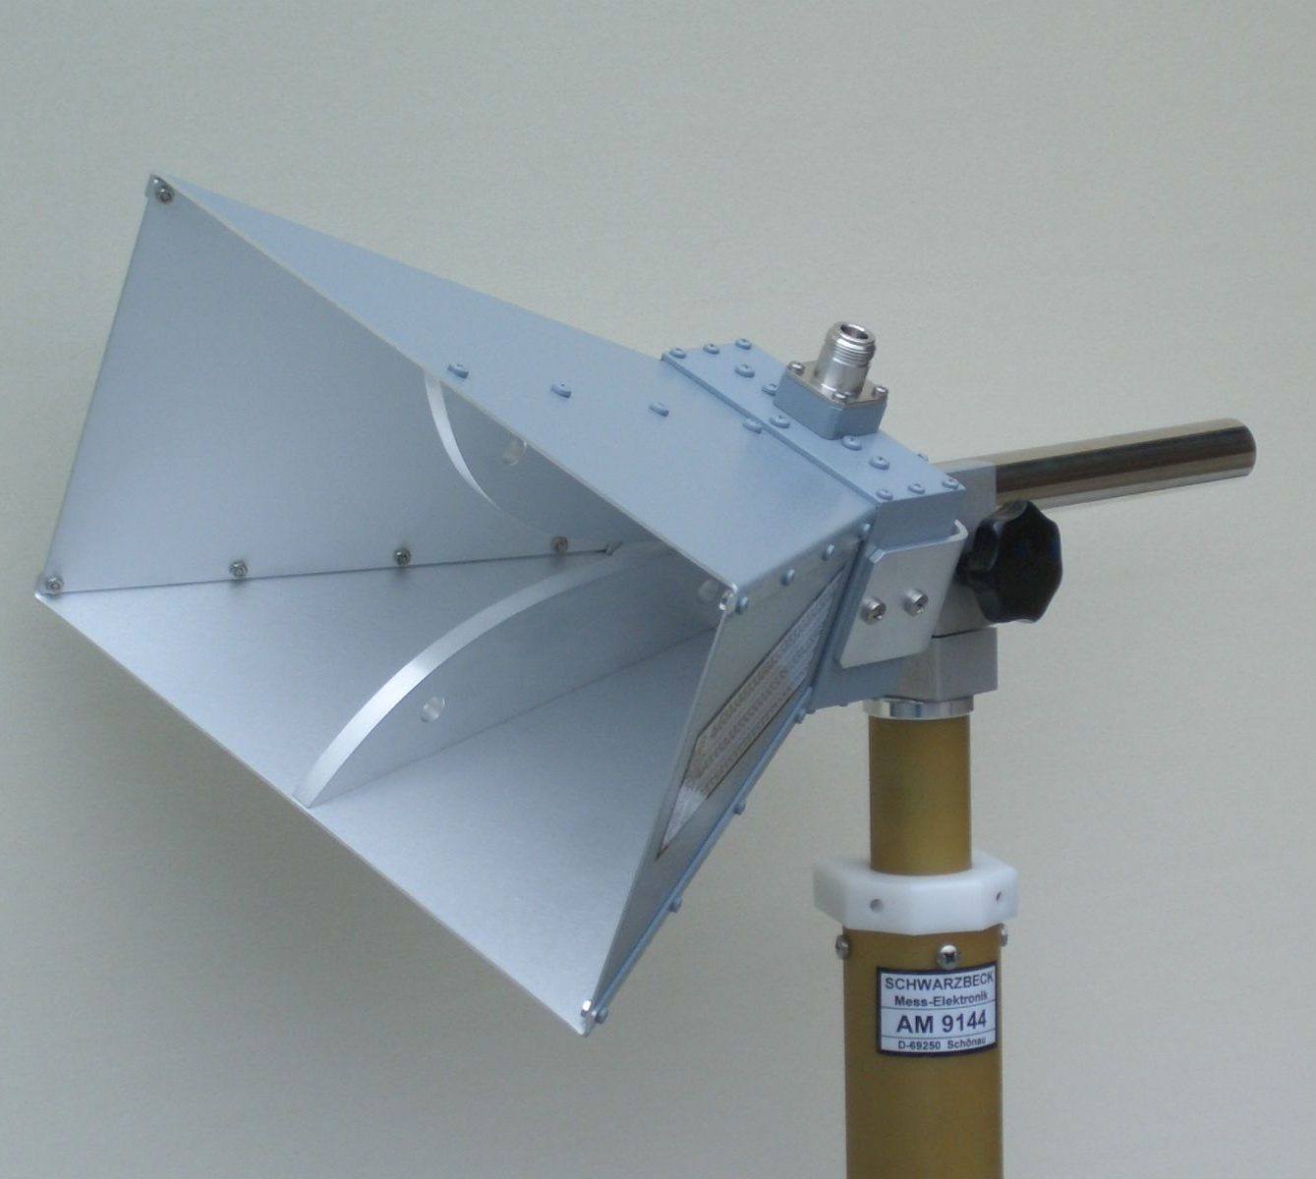
Horn Antenna
Unidirectional antenna
Frequency range above 300 MHz
Transmit radio waves from a waveguide (a metal pipe used to carry radio waves) out into space or collect radio waves into a waveguide for reception
Gain is very high in the direction of the horn’s axis
Use as antennas at UHF & microwave frequencies

Slide 20
Horn Antenna Transmissions

Slide 21

Thank You

